Slide 1
Programming Team Workshop #2
December 1

Slide 2
Programming Assignment
Goal: Print the odd numbers between 1 and 10 to the console
Hints:
Use the modulus operator (%) to determine whether the number is odd or even
System.out.println();
Restriction:
Only one println statement

Slide 3
Programming Assignment
Member submission:
public class Workshop1Alternate {
public static void main(String[] args) {
int[] unevenNumbers = {1, 3, 5, 7, 9,};
for (int i = 0; i < unevenNumbers.length; i++) {
System.out.println(unevenNumbers[i]);
}
}
}

Slide 4
Programming Assignment
Very good use of topics we’ll be covering tonight:
Arrays
Using the length method for loop control
There are a couple “gotchas”
Hardcoding values should be done only when absolutely necessary (e.g., the value of pi)
Scalability. If the assignment was for odd numbers from 1 to 100, hardcoding is unmanageable.

Slide 5
Programming Assignment
John’s program:
public class Workshop1 {
public static void main(String args[]) {
for (int idx = 1; idx <= 10; idx++) {
if ( (idx % 2) > 0) {
System.out.println(idx);
}
}
}
}

Slide 6
Programming Assignment
No need for hardcoding
Step through the numbers sequentially
The modulus function determines whether the number is odd or even
Scalabiilty: Only a single value needs changed to increase the upper limit
Upper limit value also could be passed as a command-line argument

Slide 7
Wrapper Classes
Primitive datatypes are not objects
Advantage:
Less overhead
Higher performance
Disadvantage
Can’t be used for Java methods that require objects as arguments
Advanced math functions require objects as arguments

Slide 8

Wrapper Classes
Wrapper classes hide the primitive datatypes, disguising them as objects

Slide 9
Wrapper Classes
Names of wrapper classes are the same as the primitive datatype, except with initial cap
Remember: Java is case sensitive.
Two exceptions to naming:
Integer for int
Character for char

Slide 10
Wrapper Classes
Times to use wrapper classes:
Calling a method that requires an object as an argument
Using constants defined by the class
Example: MIN_VALUE, MAX_VALUE
Converting between primitive datatypes or between numbering systems

Slide 11
Wrapper Classes
Manual declaration/initialization (boxing):
Integer someInt = new Integer(12);
Automatic conversion (autoboxing):
Integer someInt = 12;

Slide 12
Arrays
Variable declaration
datatype[] arrName = new datatype[arrSize];
int[] someArray = new int[5];
Indexing is Base 0
Valid indexes are 0 to (arrSize – 1)

Slide 13

Arrays
Most common error when using arrays is specifying an invalid index

Slide 14
Arrays
To avoid when looping:
Use length method
for (int idx = 0; idx < arrName.length; idx++)
Use foreach loop
for (int arrElement : arrName)

Slide 15
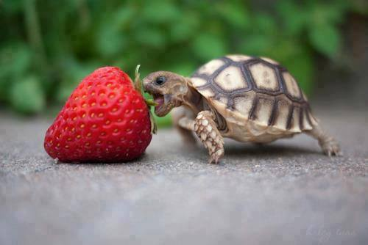
Exceptions

Slide 16
Exceptions
int[] arrInt = new int[2];
int arrIndex = 2;
try {
arrName[arrIndex] = 0;
} catch (ArrayIndexOutOfBoundsException e) {
System.out.println(“Remember: base 0”);
}

Slide 17

Classes/Methods
Java program is a class that contains a main() method
Let’s go for a drive….
But first we have to build our car….

Slide 18

Questions?

